Slide 1
PBHLT 7115 Causal Methods in Public Health
Week 1
Session 1a: Introductions and introduction to Causal Methods
Jan 9th, 2024

Slide 2

Agenda
Introductions
Goals (of causal models and of course)
Software (R, Python, Stata) & course logistics
Introduction to paradigm shift in our field
What is “counterfactual” & our definition of cause
Example and introduction to bias and confounding
Directed Acyclic Graphs (DAGs) as powerful tools
Exchangeability
Remarks on marginal vs conditional (and when conditional = marginal)
RCTs and observational data
Assignment & Discussion of reading and conclusions/parting thoughts

Slide 3


Andy Wilson, PhD, MStat
Hello!
Adjunct asst prof – still get to do all kinds of cool collaborations
Former director of applied statistics at College of Nursing: Championed all things “reproducibility”
“Head of innovative RWD Analytics”
Lately really interested in causal inference and machine learning – and the intersection of “Targeted Learning”

Slide 4
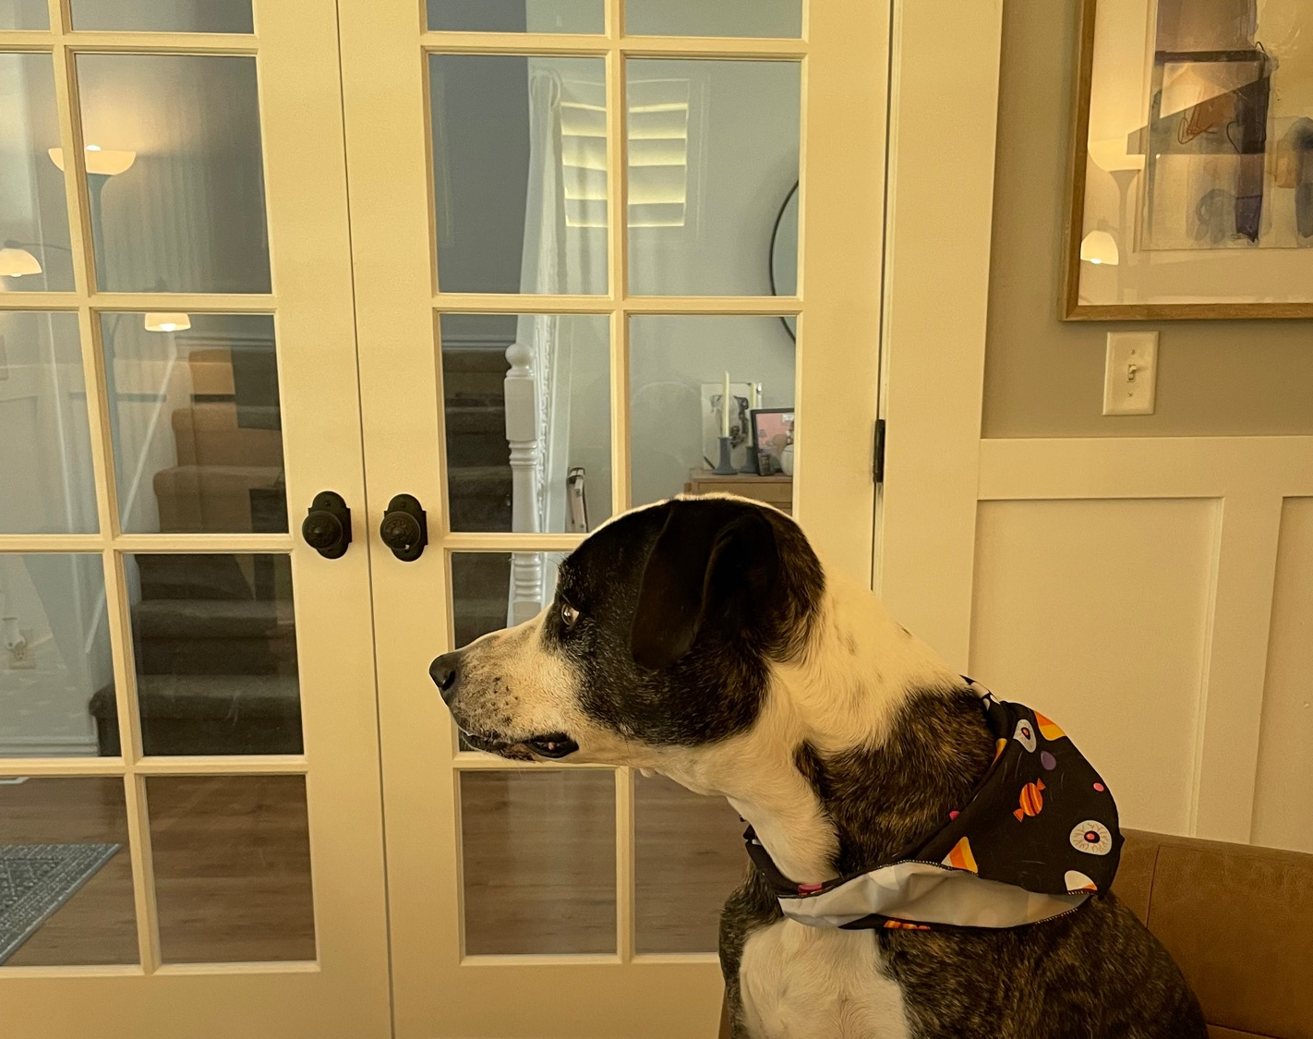
Introductions
Who you are and what you are up to
Experience with epi/public health
Software of choice

Slide 5
Goals
Of (modern) Causal Methods
Of this course
Mathematize the conditions under which association implies causation
Provide new or modified statistical methods to assess causality
Focus on manipulable interventions but can be (carefully) extended to other exposures and sociodemographic factors
Lay the analytic foundations to perform and interpret causal analysis
Enhance both how you produce and (critically) consume causal methods & models
Help you be better citizens in the causal and real-world data revolution

Slide 6



Software
General purpose stats software
Favorite of epidemiologists and Economists ☺
Treatment effects ~ causality
May be direction of the future
TLVerse.org (currently only in R)
Community ~ e.g., realities for super learning
Some worked examples in Python – example for multiple causation and ‘the deconfounder,’ DiCE, DML and more

Slide 7
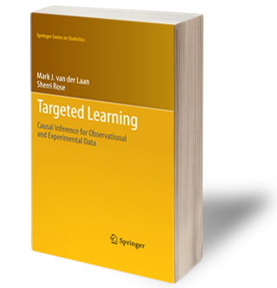
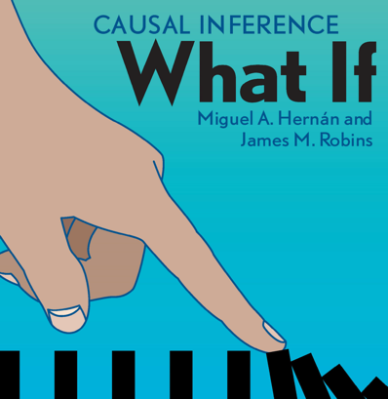
Textbook(s)
Laan MJ van der, Rose S. Targeted Learning: Causal Inference for Observational and Experimental Data. Springer; 2011. (free to download from the CANVAS page with permission from the author)
Hernán MA, Robins JM (2020). Causal Inference: What If. https://www.hsph.harvard.edu/miguel-hernan/causal-inference-book/

Slide 8
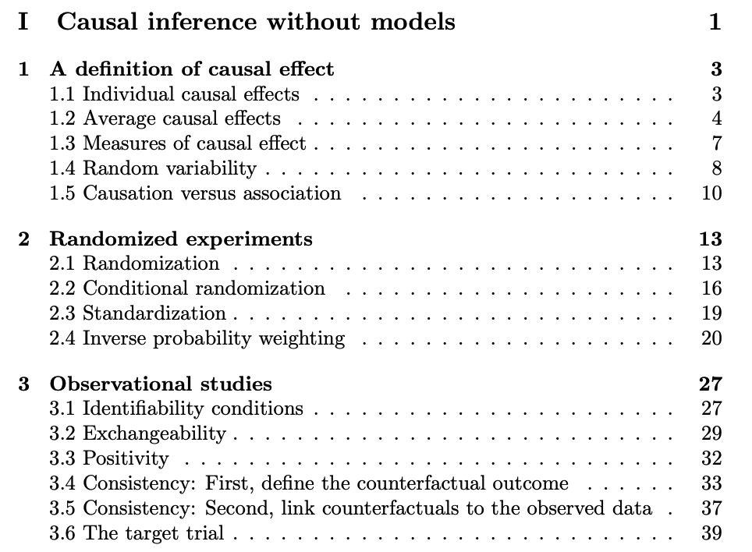
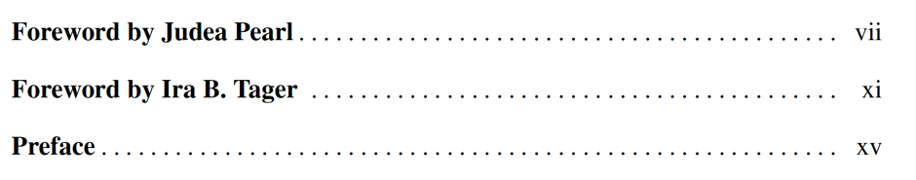
Readings
From Hernán and Robins: Ch 1-3
From van der Laan TL book: Forwards and Preface

Slide 9
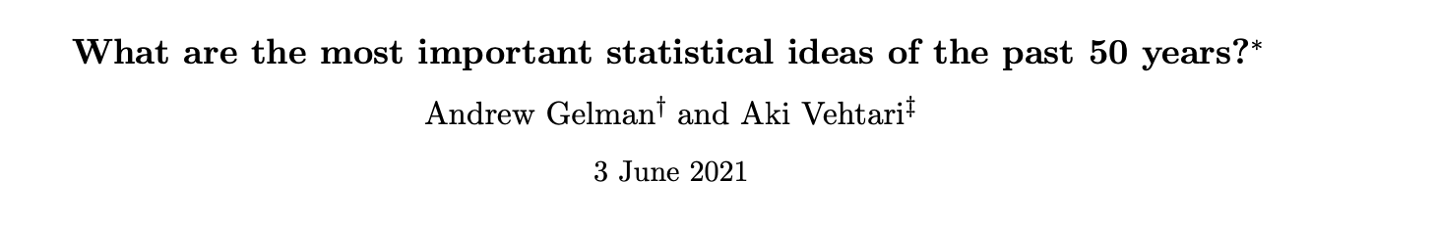

STATS50
#1: Counterfactual causal inference
“The key idea is that causal identification is possible, under assumptions, and that one can state these assumptions rigorously and address them, in various ways, through design and analysis.”
2021 Nobel economics prize
In econometrics the focus has been on the structural models and their implications for average treatment effects (Imbens and Angrist, 1994), in epidemiology the focus has been on inference with observational data (Greenland and Robins, 1986)
1994
†Department of Statistics and Department of Political Science, Columbia University, New York.
‡Department of Computer Science, Aalto University, Espoo, Finland.
∗To appear in the Journal of the American Statistical Association.

Slide 10

“counterfactual” & cause
What would have happened had one thing been different (all other things being equal)? (causal contrast)
Food for thought:
This is a highly-individualized story (does an average effect even make sense?)
What if she chooses to go through the door vs being assigned? Or, what about the kind of person who makes trains vs misses them – are they comparable? (exchangeable)
Sliding Doors is a 1998 romantic comedy-drama starring Gwyneth Paltrow. The film alternates between two storylines, showing two paths the central character's life could take depending on
whether
or not
she catches a train.
Observed Gwyneth
(individual) causal effect of catching train
Counterfactual Gwyneth

Slide 11
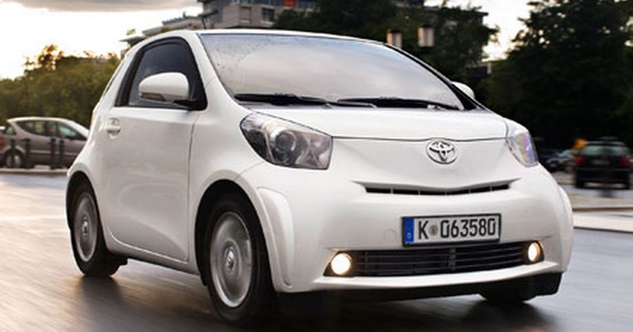
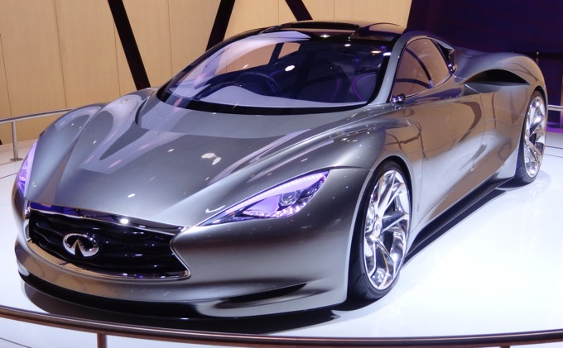
bias and confounding
Parable of (observed) car safety
Observational data: how the world presents itself to us

Slide 12
(Favors Economy)
Collect “real world” data – Car Type & Accident Status (1 year)
VIN | Type | Accident in 1 yr. post sale
JH4DA9340PS000417 | Economy | 0
KNDPB3A21B7082471 | Economy | 0
… | …. | …
JNKCV64E78M131002 | Sport | 1
Compare accident rates and observe economy car has lower accident rates by 5%.

Slide 13
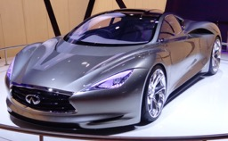
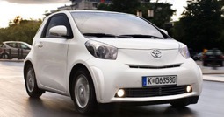
But what if we consider factors involved in car selection?
Say we conduct a baseline survey and notice a difference in ‘safety profile’ between those who choose an economy car vs sport?
This safety profile favors the economy car.
So, was this a ‘fair comparison’?

Slide 14
And we notice differences in this baseline driver safety profile in the outcome …
We notice a clear separation of safety profiles by whether car was involved in an accident.

Slide 15

We’d like some method of organizing our potential drivers

Slide 16
Distorted association when not controlling for the confounder
Common cause confounding

Slide 17
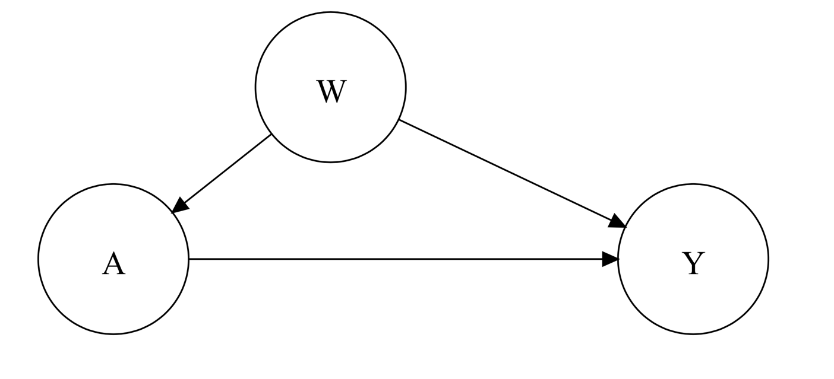
Directed Acyclic Graphs (DAGs)
Directed acyclic graphs (DAGs) are visual representations of causal assumptions
They encode our assumptions about the way variables relate to each other
DAGs can help untangle seemingly paradoxical findings and inform analyses
External factors
For a more formal treatment, I recommend:
Shrier, I., & Platt, R. W. (2008). Reducing bias through directed acyclic graphs. BMC Medical Research Methodology, 8, 70. https://doi.org/10.1186/1471-2288-8-70
Treatment
Outcome

Slide 18
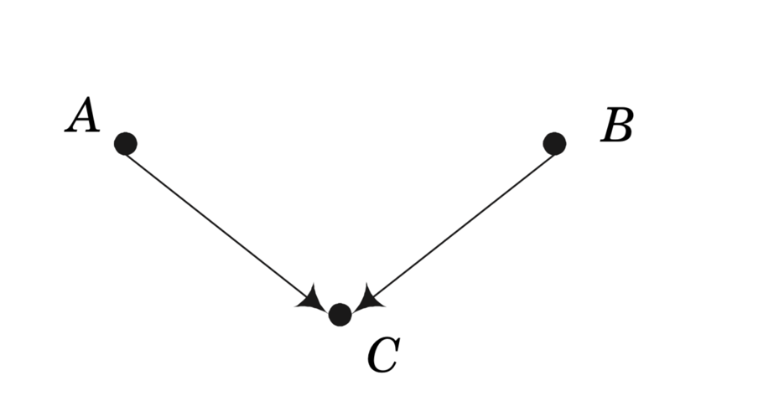
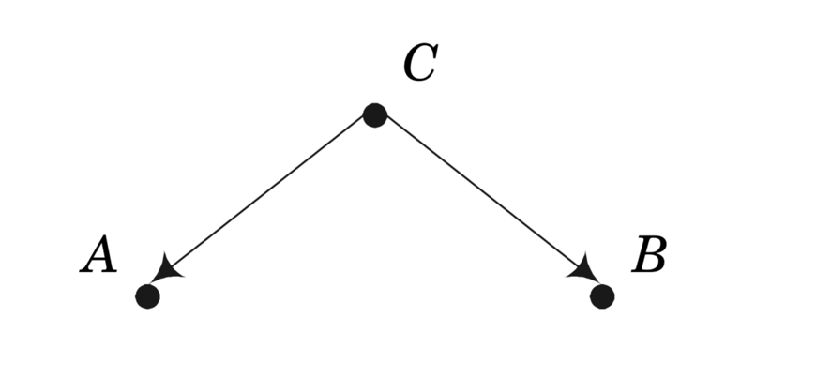
DAGs representing confounding
Common cause confounding
Collider
Smoking
Bad egg-salad
Influenza
Carry lighter
Lung cancer
Fever
Distorted association when not controlling for the confounder
Distorted association when controlling for the collider

Slide 19
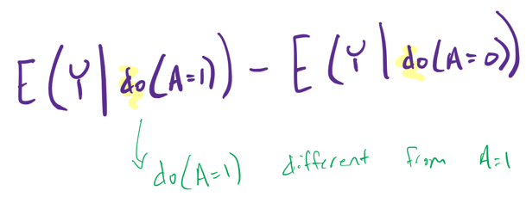
Conditional vs Marginal
Additional question: why were you in that strata in the first place?
In summary: we want to account for why we observed someone in their strata
“marginal counterfactual estimates of the outcome”
VIN | Safety profile | W₂ | Type | Accident in 1 yr. post sale
JH4DA9340PS000417 | 74.7 | … | Economy | 0
KNDPB3A21B7082471 | 73.2 | … | Economy | 0
… | … | … | …. | …
JNKCV64E78M131002 | 36.5 | … | Sport | 1

Slide 20
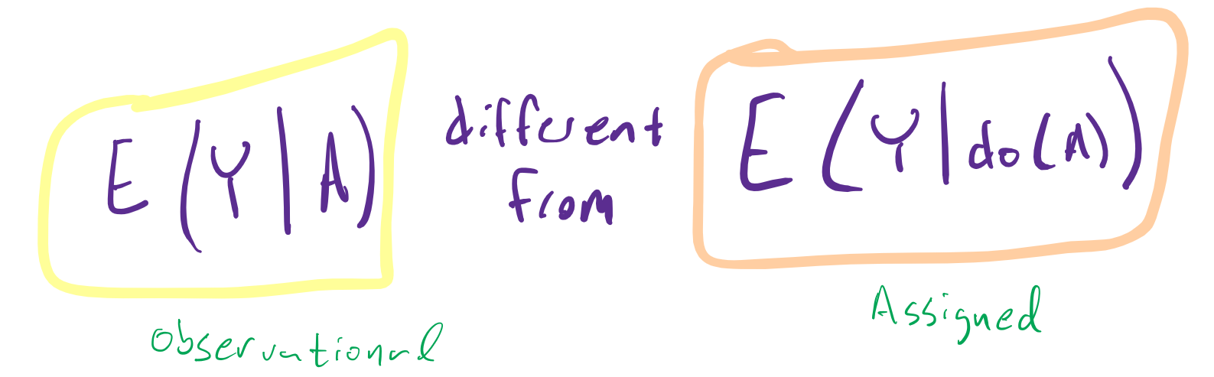

do(A)
We say that A and Y are not confounded if and only if
P(Y | do(A)) = P(Y | A)

Slide 21
(Favors Sports)
Collect “real world” data – Car Type & Accident Status (1 year)
But now account for baseline differences (propensity to choose car)
VIN | Safety profile | W₂ | Type | Accident in 1 yr. post sale
JH4DA9340PS000417 | 74.7 | … | Economy | 0
KNDPB3A21B7082471 | 73.2 | … | Economy | 0
… | … | … | …. | …
JNKCV64E78M131002 | 36.5 | … | Sport | 1
Sports car has lower accident rates by 11%. (IF we could have assigned people to car type)

Slide 22

Randomized Clinical Trials and Causal Effects

Slide 23
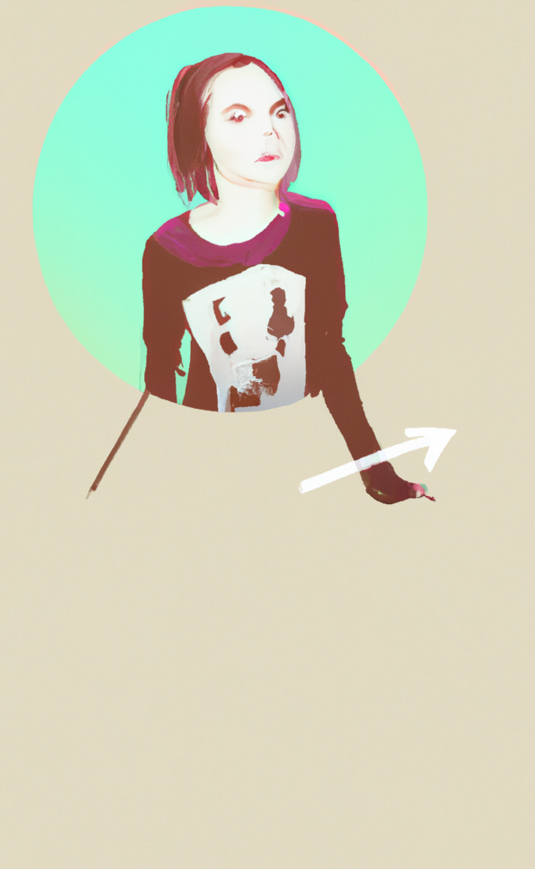
Harry and the ProCess Randomized Clinical Trial
This is Harry. He shows up in an emergency department with a widespread infection and septic shock, leading to very low blood pressure.
He agrees to be randomized into the ProCess study. He is patient i=17. Male, age 52, with sepsis from pneumonia, he has APACHE II score of 23, systolic blood pressure (SBP) of 96.1, and serum lactate of 5.3.
Compared to the other participants in Table 1, he is a little younger, but a little sicker.
Call his observed covariates X_{i} and everything else about his past U_{i .} By coin flip, he gets the aggressive intervention.

Slide 24
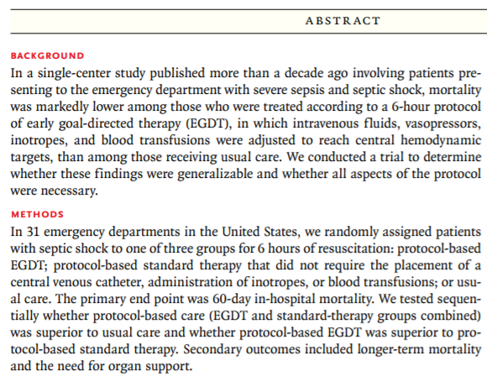
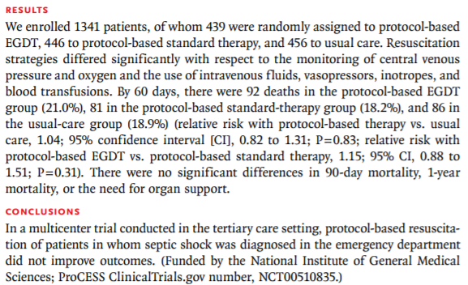
ProCess study as an example of a randomized clinical trial

Slide 25
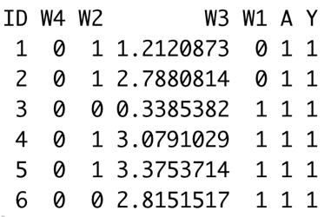

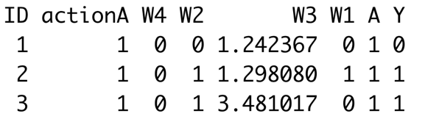
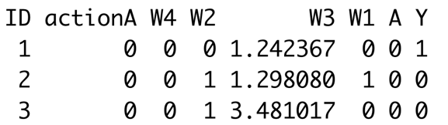
Idea of observed vs FULL data
Observed
Y(0) - Y(1) from different people
A
A=1
Y(1)
Y
A=0
Y(0)
Full
Y(0) - Y(1) from same person
A=1
Y(1)
A
Y
A=0
Y(0)

Slide 26

Harry and the ProCess Randomized Clinical Trial
Call Harry’s [#17] observed covariates X_{i} and everything else about his (unknown) past U_{i .} By coin flip, he gets the aggressive treatment, so Z₁₇=1. (For the less aggressive intervention Z_{i}=0.)
His outcome is y_{T,17}, but if he had gotten the other treatment, his outcome would be y_{C,17}. So we would have complete information about whether the aggressive intervention T was better than the control intervention C for Harry, if we knew both (y_{T,17}, y_{C,17} ). Instead, we only know Y_{T,17}=0, i.e., he didn’t die in the first 60 days.
potential outcomes
actual outcome

Slide 27

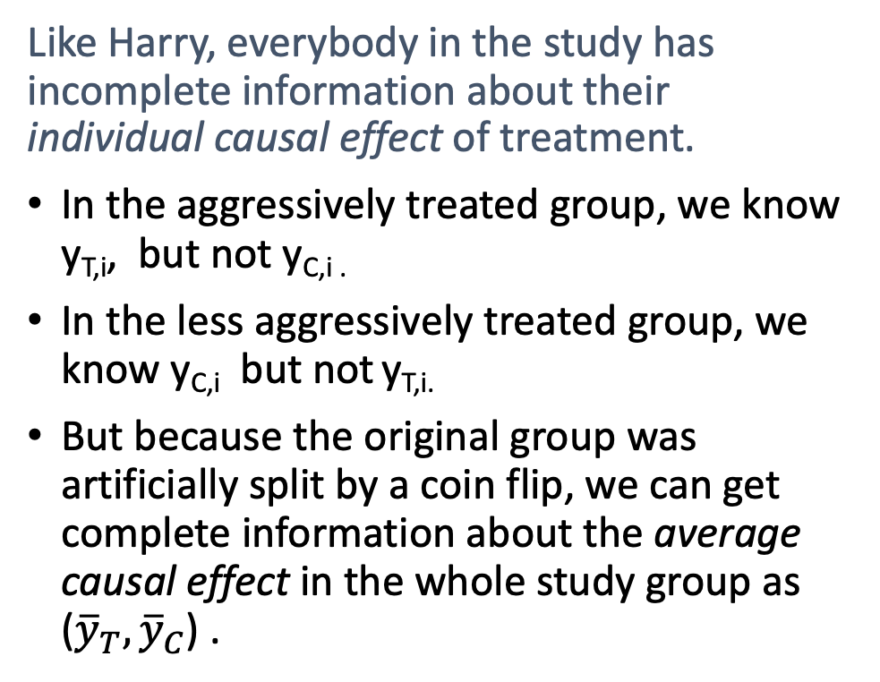
Harry and the ProCess Randomized Clinical Trial
Like Harry, everybody in the study has incomplete information about their individual causal effect of treatment.
In the aggressively treated group, we know y_{T,i}, but not y_{C,i .}
In the less aggressively treated group, we know y_{C,i} but not y_{T,i.}
But because the original group was artificially split by a coin flip, we can get complete information about the average causal effect in the whole study group as (${\overline{y}}_{T}, {\overline{y}}_{C}$) .

Slide 28

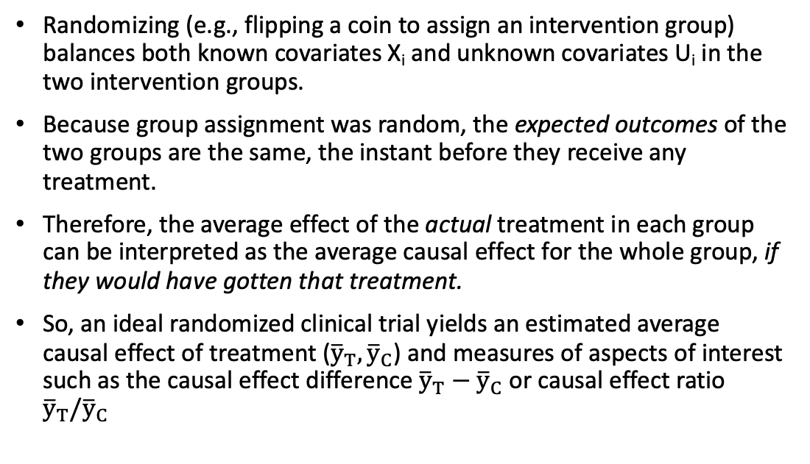
Take-home
Randomizing (e.g., flipping a coin to assign an intervention group) balances both known covariates X_{i} and unknown covariates U_{i} in the two intervention groups.
Because group assignment was random, the expected outcomes of the two groups are the same, the instant before they receive any treatment.
Therefore, the average effect of the actual treatment in each group can be interpreted as the average causal effect for the whole group, if they would have gotten that treatment.
So, an ideal randomized clinical trial yields an estimated average causal effect of treatment (${\overline{y}}_{T}, {\overline{y}}_{C}$) and measures of aspects of interest such as the causal effect difference ${\overline{y}}_{T}−{\overline{y}}_{C}$ or causal effect ratio ${\overline{y}}_{T}/{\overline{y}}_{C}$

Slide 29

What about non-randomized studies?

Slide 30
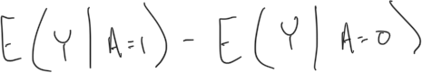
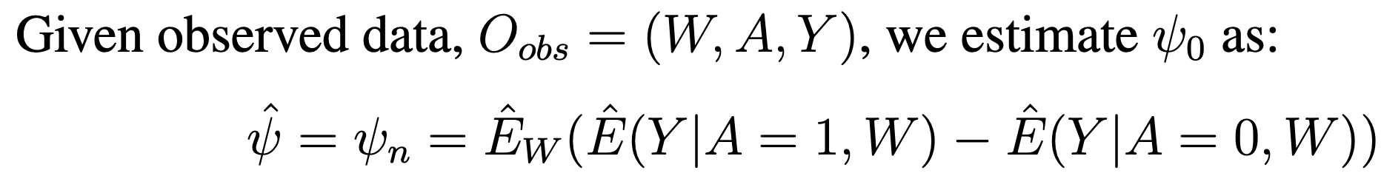
What we WISH we had
As we saw before, we would have been able to estimate effect as :
Only if groups are exchangeable. (note: easy if we had the FULL data or if randomized)
THE GOOD NEWS → we can make treatment groups exchangeable using observational data

Slide 31
So, what are some (common) analytic methods to make treatment groups exchangeable using observational data?
Regression Adjustment for confounding
Inverse Probability Weighted analyses (propensity scores)
Marginal Structural Models
G-computation estimator
Targeted maximum likelihood estimation (TMLE)
This will make up the majority of this course ☺

Slide 32
Concluding thought
We live in interesting times

Slide 33
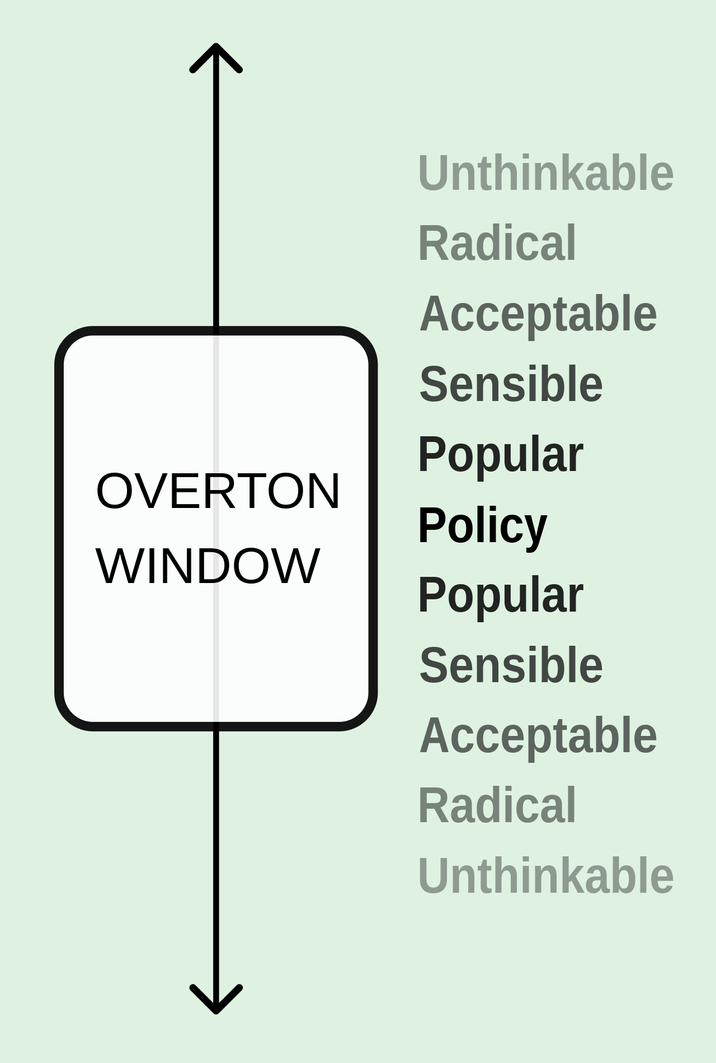
Acceptable discourse and shifting the Overton window
Overton window, Hallin’s spheres, moral relativism:
Sphere of deviance
Sphere of (legitimate) controversy
Sphere of consensus

Slide 34
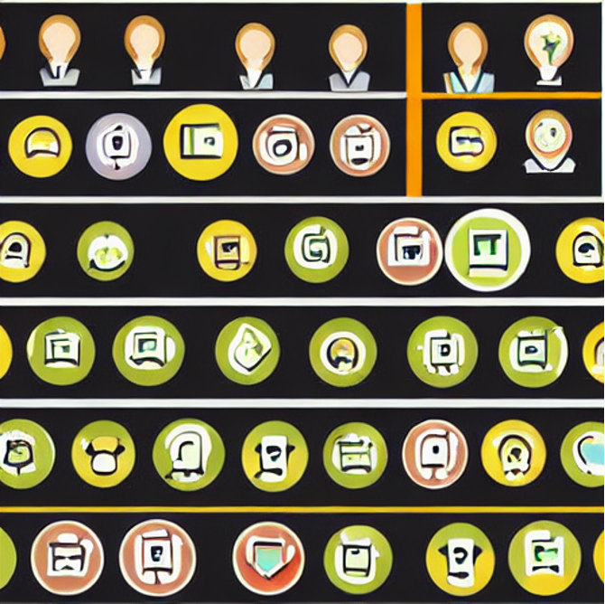
Common ground to move forward
What we ‘wish’ we could have observed – the fundamental problem of causal inference is a missing data problem.
Intuitively, we can never see someone in both treatment conditions.
Because of the fundamental problem of causal inference, unit-level causal effects cannot be directly observed.
However, randomized experiments allow for the estimation of population-level causal effects.
Notes:
Near consensus on this
As Susan Gruber said: “Meet people where they are” And they’re usually at least at counterfactuals.

Slide 35
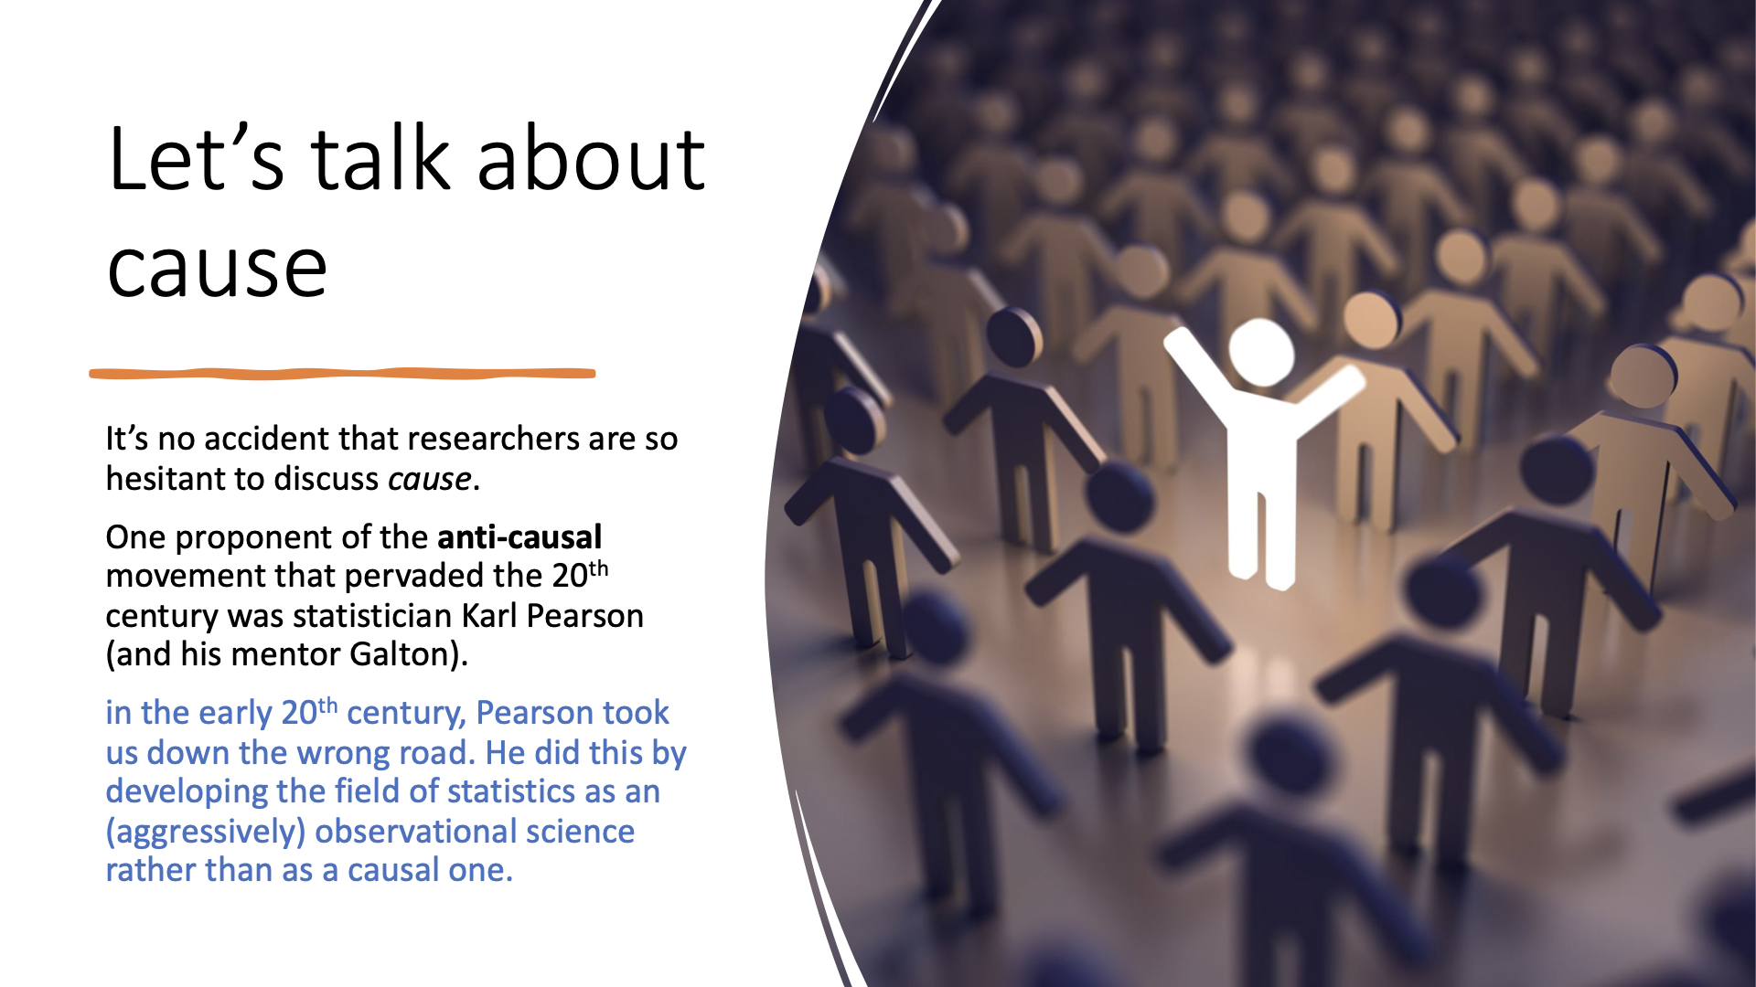
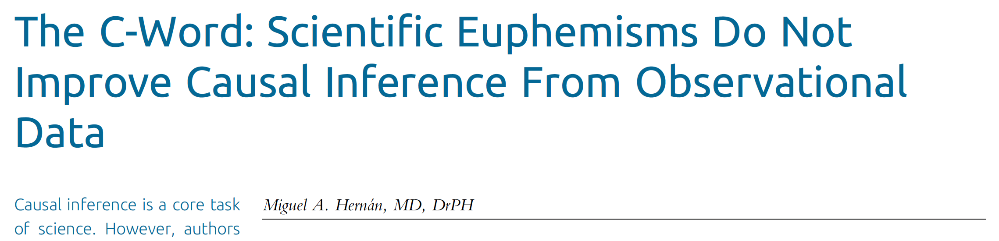

Slide 36
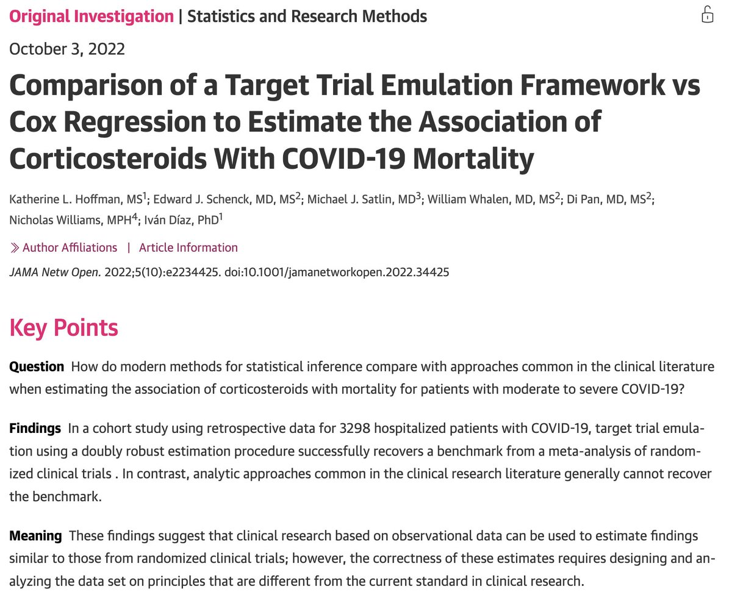
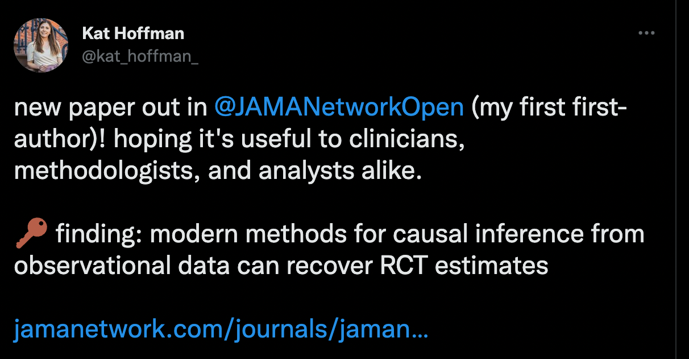
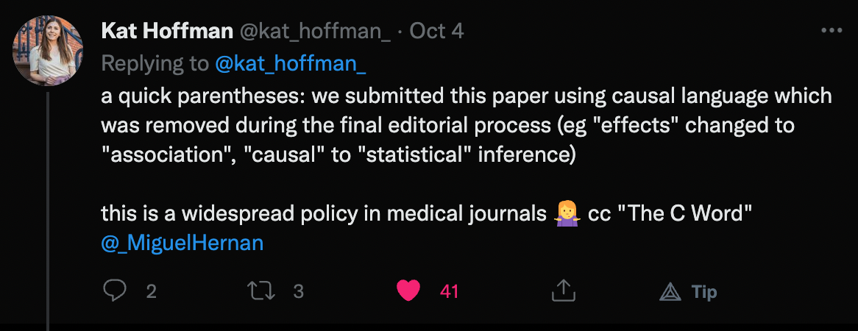
Sphere of deviance
Sphere of (legitimate) controversy
Sphere of consensus
Notes:
Used with permission from Katherine Hoffman

Slide 37



Recap

Slide 38
Counterfactuals and Cause
DAGs
Example with confounding
Pearl’s “do(x) calculus”
Randomization
ProCess study
Methods for nonrandomized trials as the majority topic of our course

Slide 39
Next time
More on counterfactuals, formal (and informal) definitions of cause, and DAGs

Slide 40
And for readings: note – not due next time, just start reading at your own pace
From Hernán and Robins: Ch 1-3
From van der Laan TL book: Forwards and Preface

